Slide 1
Adding Your P.O.’s to ROMS
Showing just how simple it really is

Slide 2
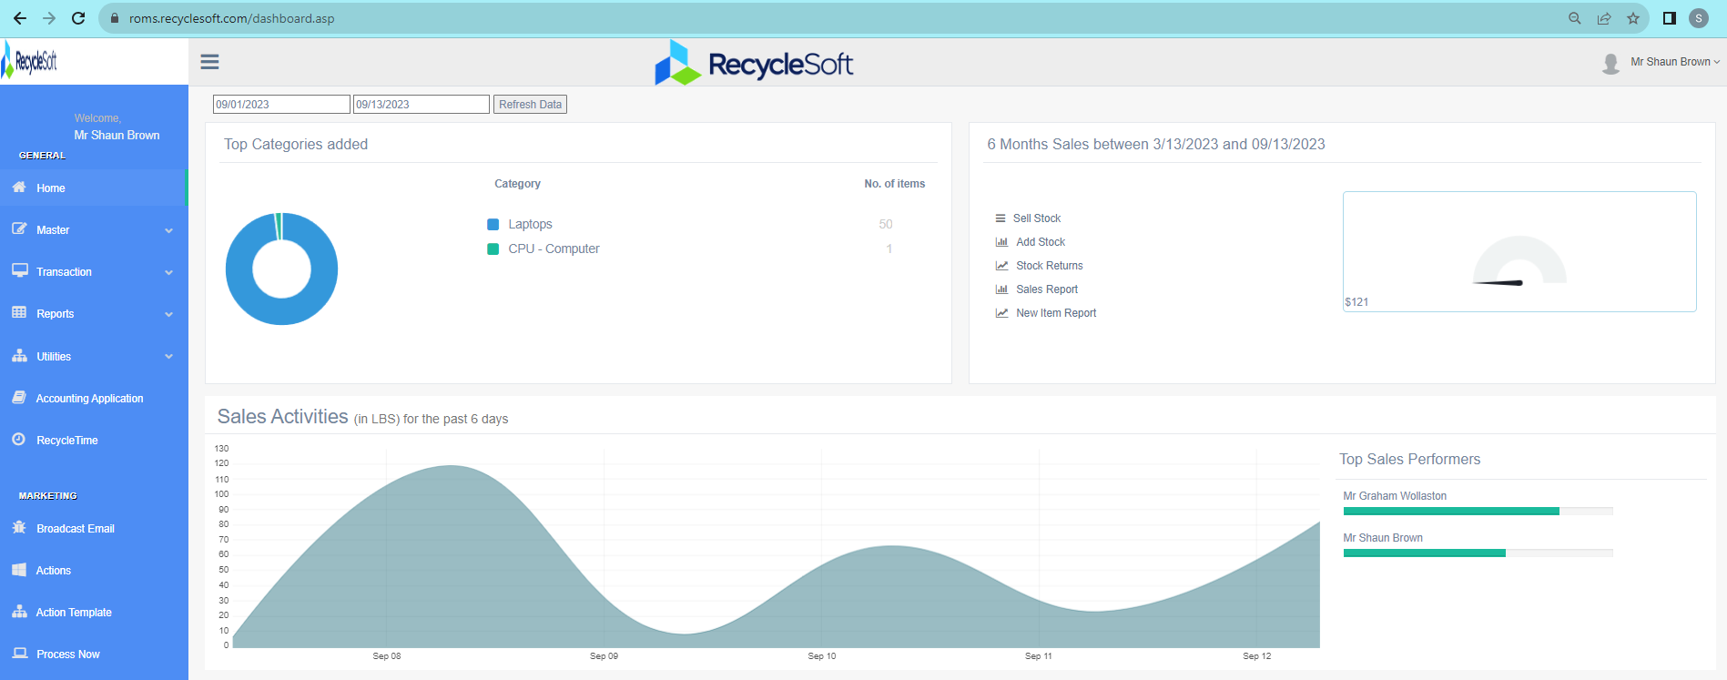
Home Screen
Start Here

Slide 3
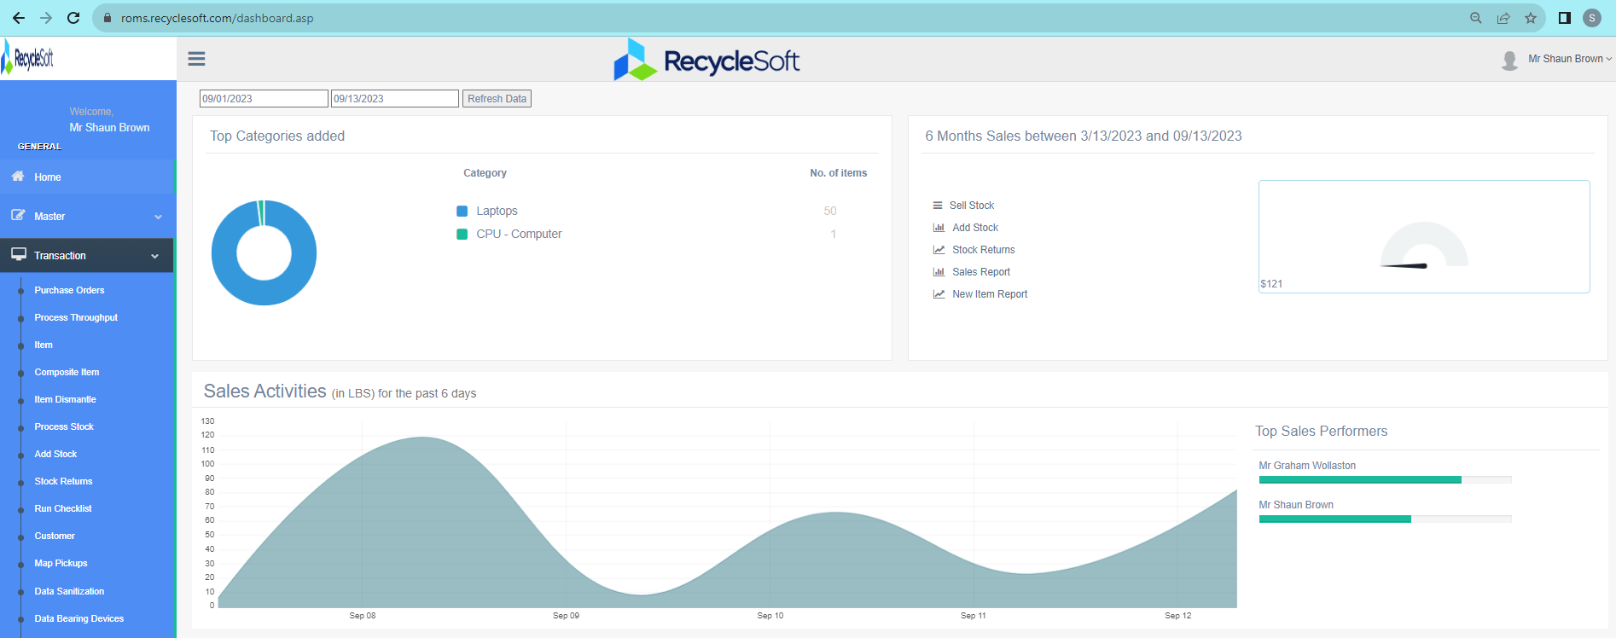
Next Here

Slide 4
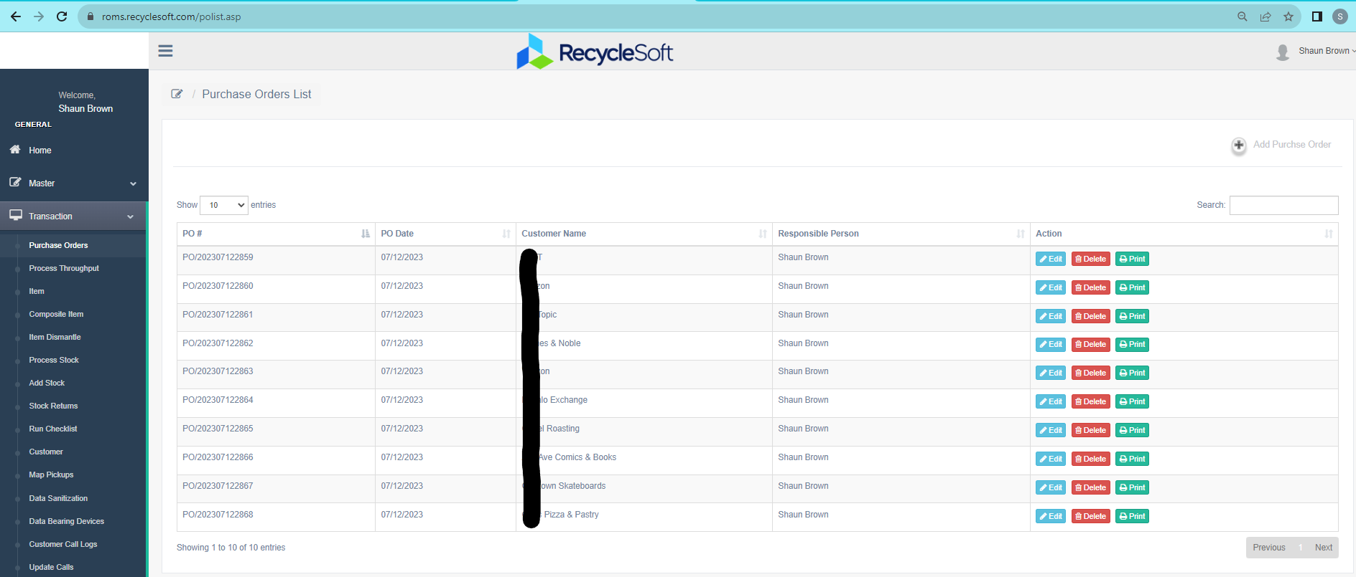
Then Here

Slide 5
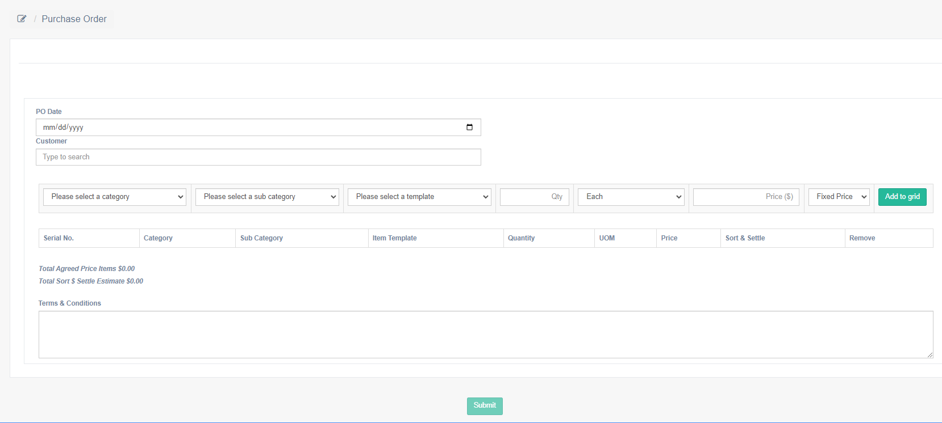
Enter PO Details
When Finished, Click Submit To Save
Add Each Line Item to the Grid

Slide 6
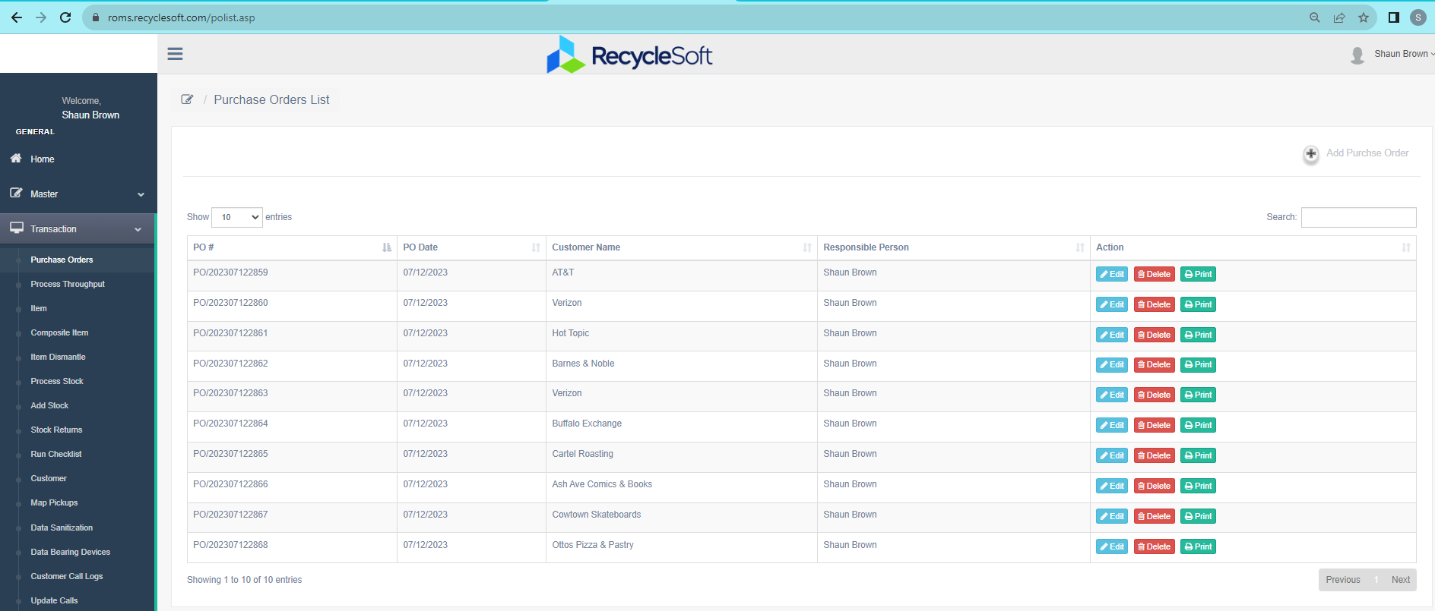
Now you can see, search, edit, & print all of your PO’s

Slide 7
Thank you!
Notes:
Yes. This looks good. Polish up

