Slide 1
Adding Inventory in ROMS
Showing just how simple it really is

Slide 2
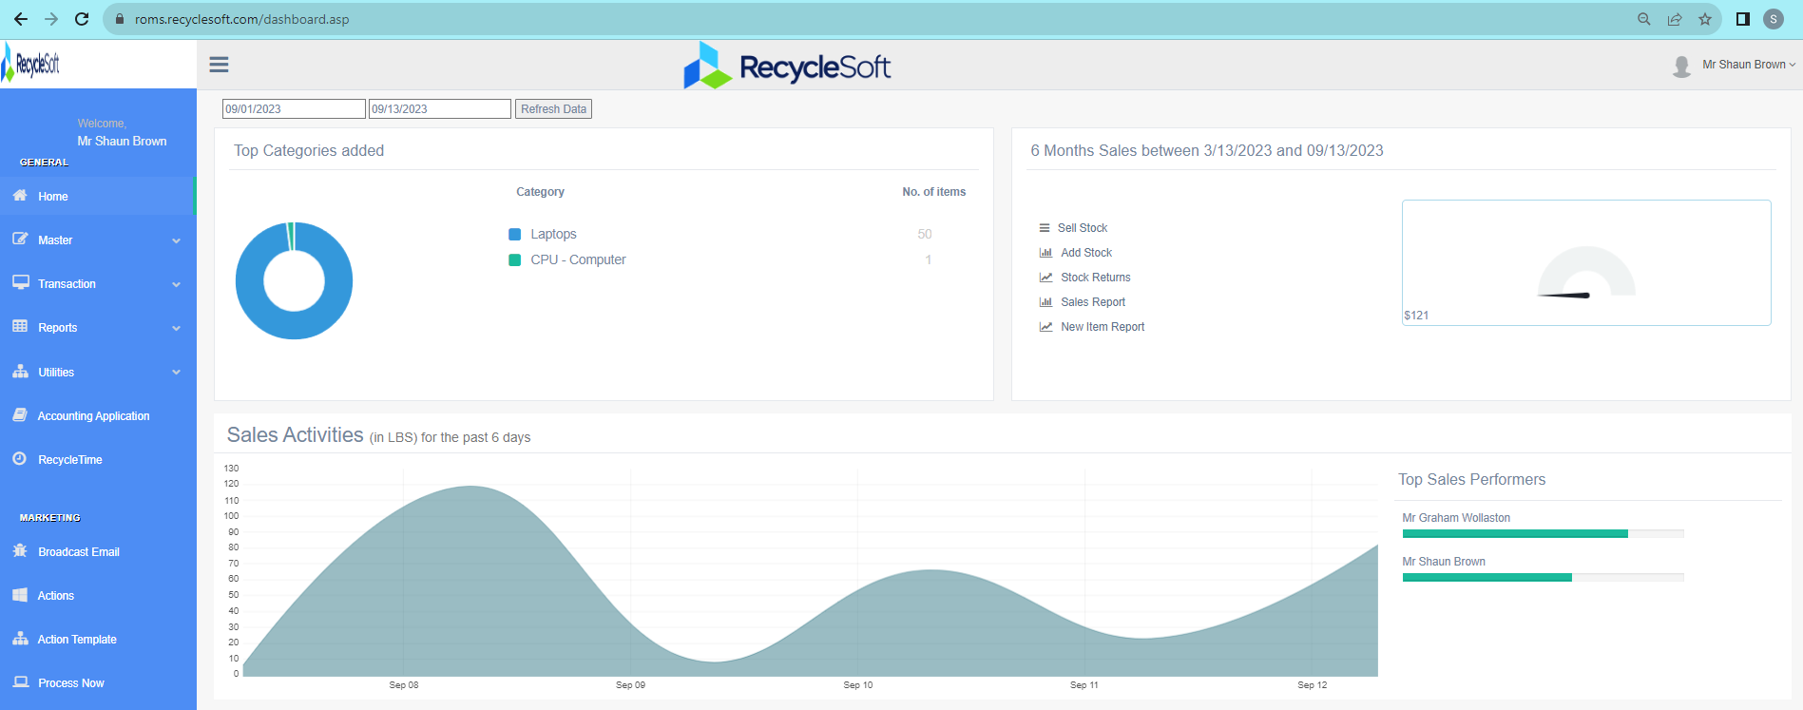
Home Screen
Start Here

Slide 3
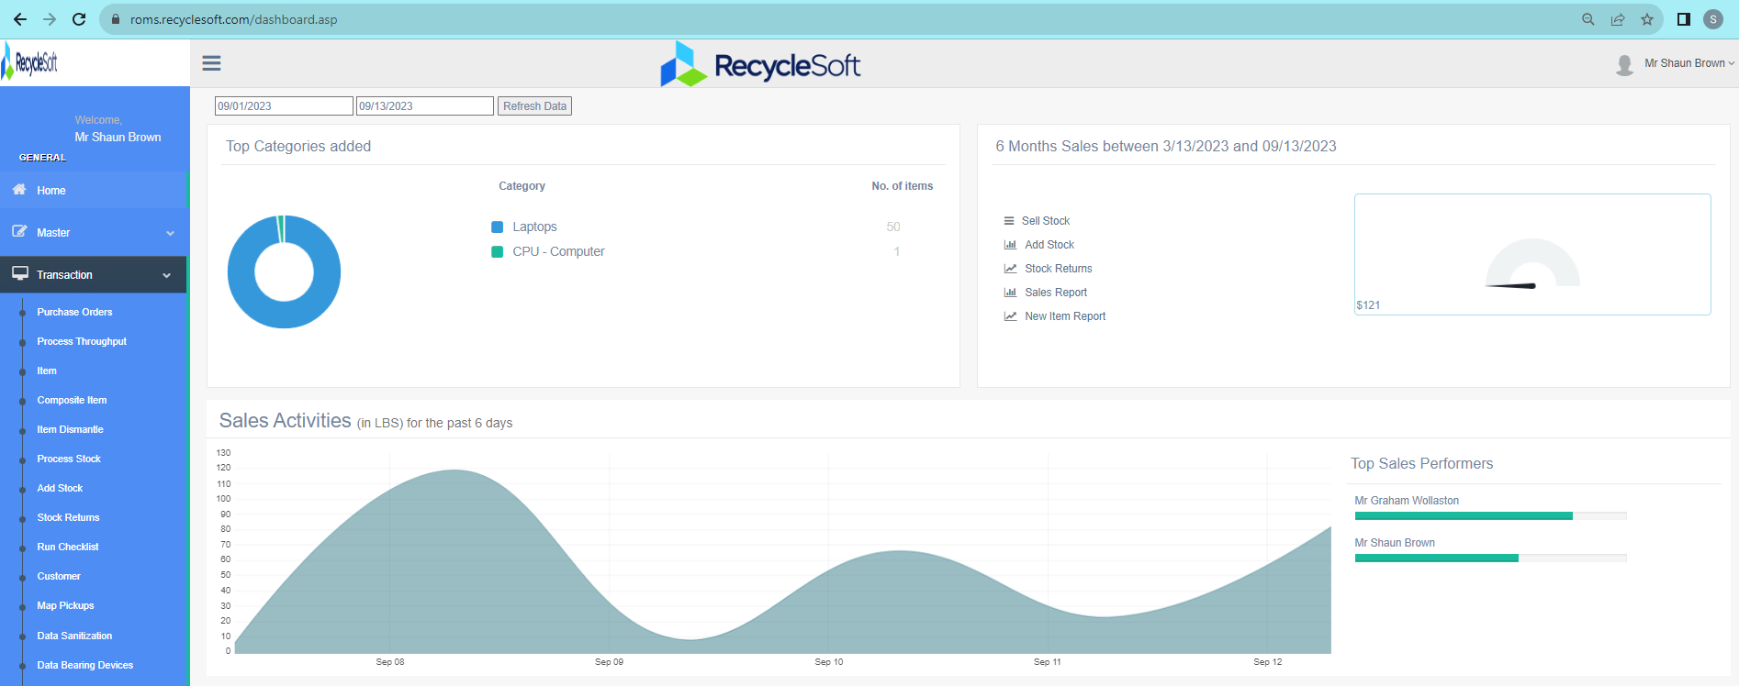
Next Here

Slide 4
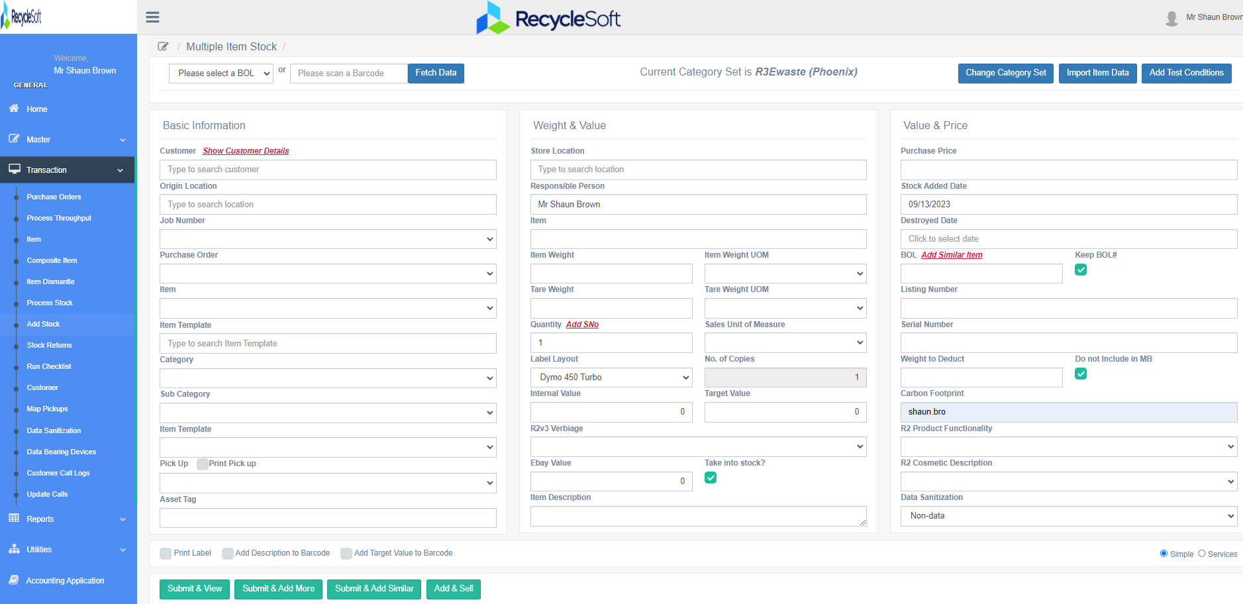
Add Basic Details in this column
Weights & Value Column
Value & Price Column

Slide 5
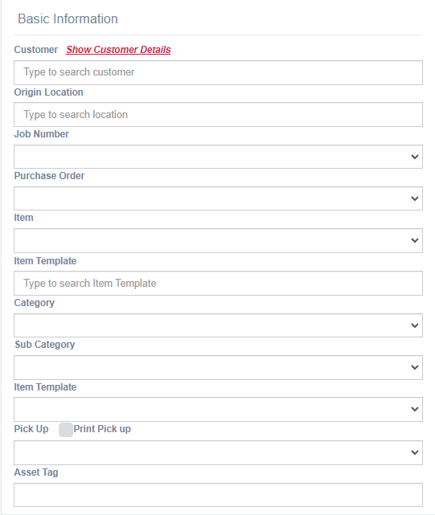
Enter Customer (Auto Completion)
Enter the Origin (Default can be set)
Enter Job Number (If Applicable)
Enter PO Number (If Applicable)
Or do a Quick Search Here
Choose Category
Choose Sub Category
Choose the Item Template

Slide 6
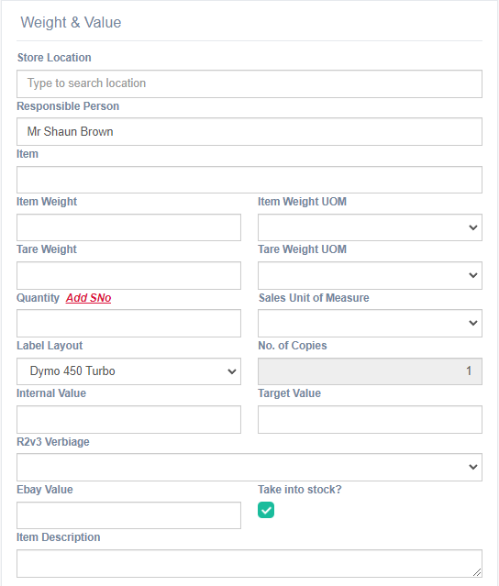
Will Auto Populate From Details Column
Will Auto Populate From Details Column
Will Auto Populate From Details Column
Enter Item Weight (Default Can Be Set)
Enter Tare Weight (Default Can Be Set)
Enter Quantity and Serial Numbers Here
Choose a Barcode Layout Here
Enter Values Here
Compliance Verbiage Here
Enter Values Here
Additional Notes Go Here

Slide 7
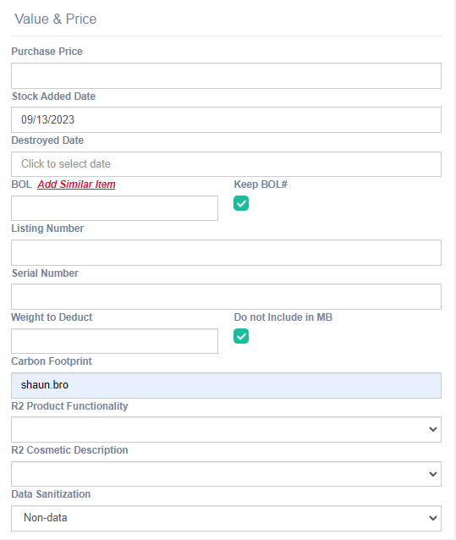
Pricing can go here
If a COD is required
Serial Number will show here
Carbon credited to goes here
Product Functionality Description
Product cosmetic Description
Data Sanitization Description

Slide 8
Now you choose what to do with the stock
Process it in and add to inventory, Defaulting the next screen to the same Customer and PO as previous entry
Process it in and add to inventory, Defaulting the next screen to the same Commodity as previous entry
Process item in and add to inventory, and sell item
Process it in and add to inventory

Slide 9
Congratulations!
Your item has been processed into stock!
You are now ready to run reports based on any values provided upon entry.
(ie date, model, qty, S/N, ect.)
Remember, the more values that you use, the more fine tuned your reporting can be!

Slide 10
Thank you!
Notes:
Yes. This looks good. Polish up

