Slide 1
Adding Your Customer
to ROMS
Showing just how simple it really is

Slide 2
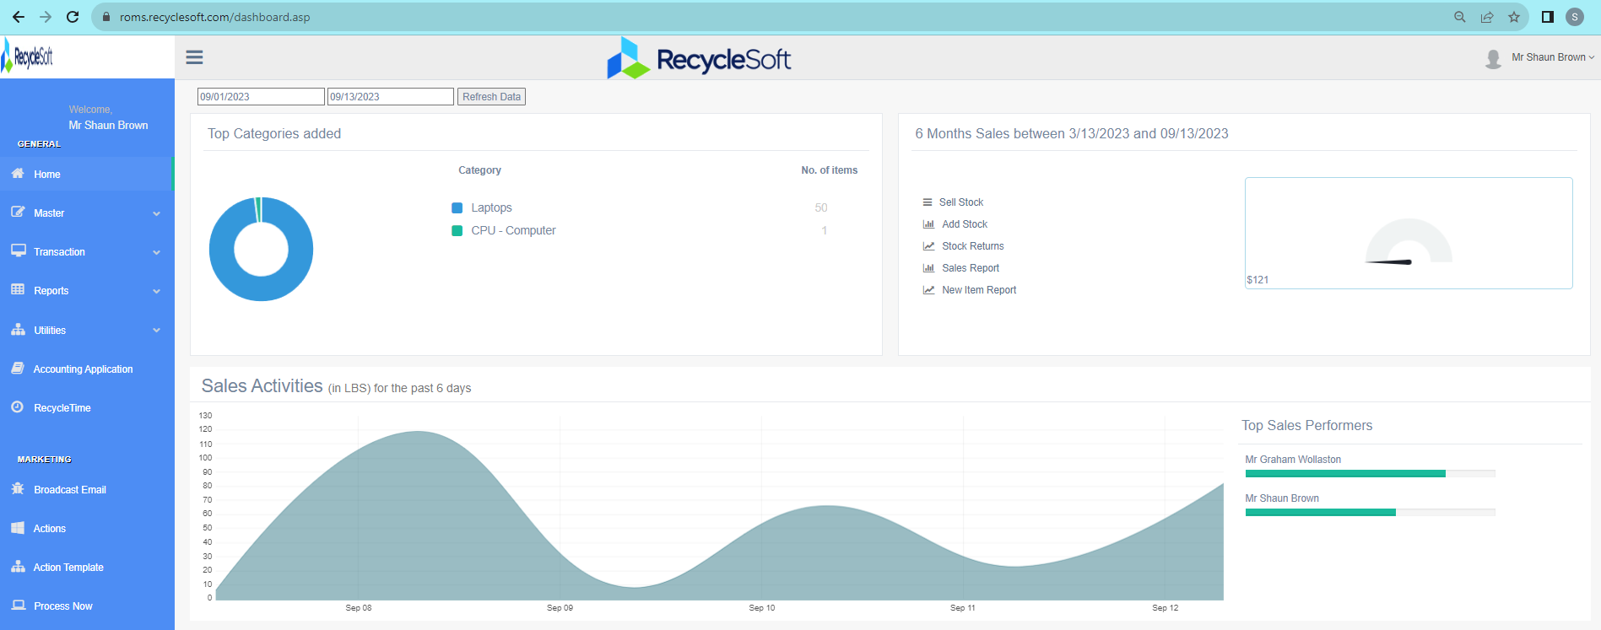
Home Screen
Fast
Simple
Easy to Navigate
Easy Training
Start Here

Slide 3
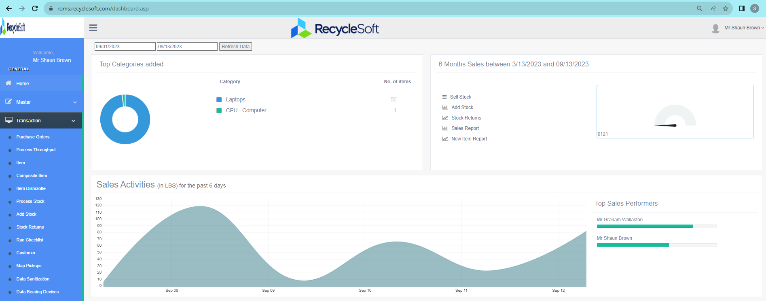
Next Here

Slide 4
Then Here

Slide 5
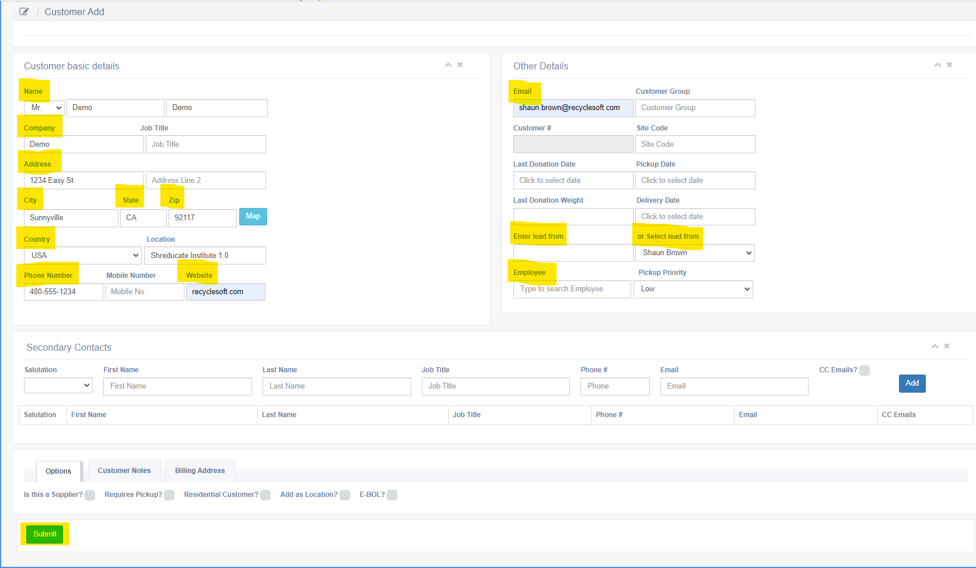
Enter Basic Info
Click Submit To Save ~
Congratulations, that's it!
You've entered a Customer!

Slide 6
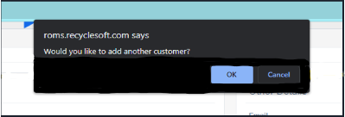
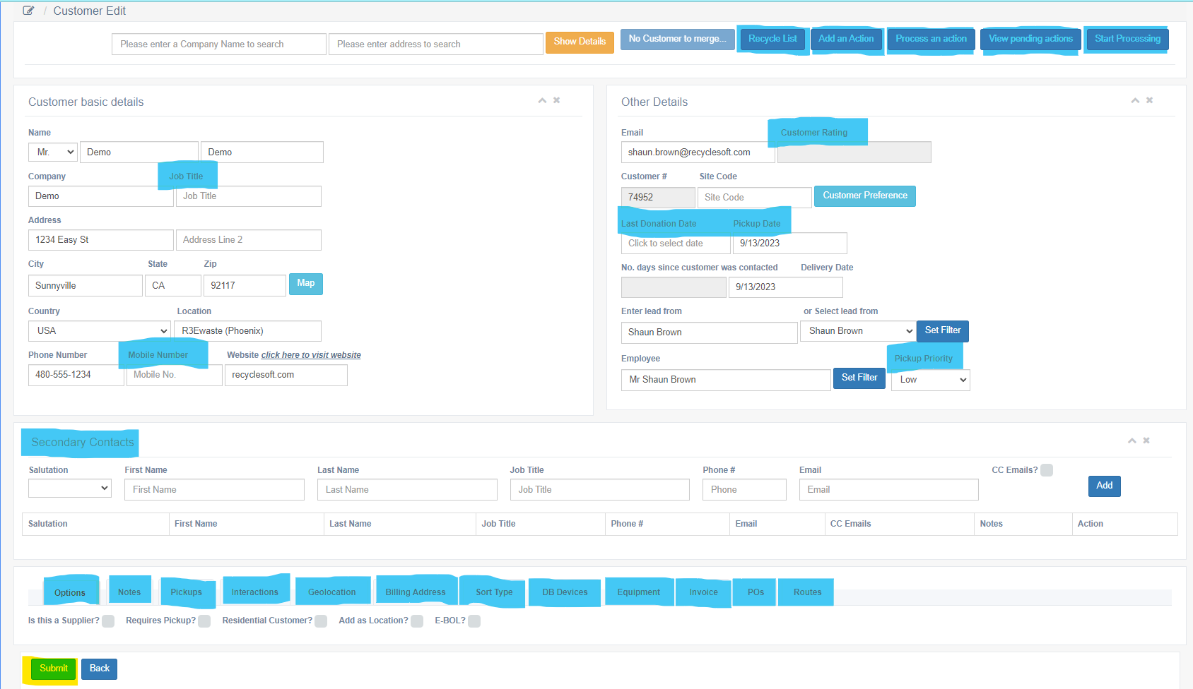
Enter Additional Info
Or Continue With Current Customer
Move on to add another customer
Click Submit To Save ~

Slide 7
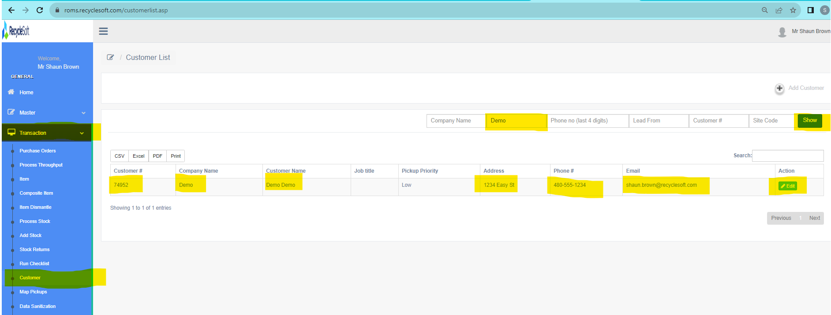
Easily Search & Edit Customers

Slide 8
Thank you!
Notes:
Yes. This looks good. Polish up

